Slide 1
Discord.py and creating a Discord bot
Made by Tóth Ádám

Slide 2

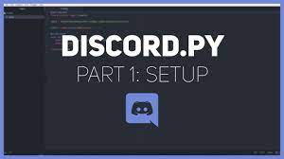
The Basics
Discord.py is a Python module that allows you to make a Discord bot that can interact with the users via commands and events. It’s an easy way to automate something on your server without paying anything.
After you downloaded Python, open a terminal, and write ”pip install discord.py” to download the module.

Slide 3
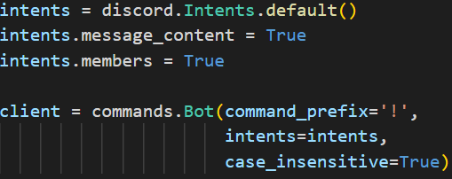

Setupping the basic code
After doing that, we need to import the discord module, and the commands module from discord.ext. Then we are ready for creating an ”intents” variable where we will store the ”discord.Intents.deafult()” value. This value stores what the type of events or values we want to use for our bot. Then create a ”client” variable, where we can store the ”commands.Bot()” value. This is the object where we can add the prefix for the commands (it can be any type of character).

Slide 4


Discord developer portal
Discord Developer Portal is the place where you can create an application, and in your application you are able to make a bot user. Sign in your Discord account and make an application. In the application, you can make a bot invite link, and with this, you can add it to your server.

Slide 5
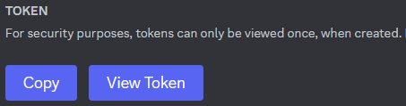
Bot token
In the Bot tab, you can ask your bot’s token. This token is required to run your script. Without the token, the script won’t know what is the bot you are referring to. The token is an extremely long code. It has letters, numbers and symbols. It is something like this: MTEwMTI0OTA5MjY3MzMzOTU3Mw.GgrxkH.RdDZJh1WFrpYUySH3l2mN-tjlhrGCfHuiPvV1c

Slide 6

Making a command
If you want to make a command, you need to specify two things: what are you trying to make (command/event) and the function that you wanna call.
@client.command() specifies that you want to create a command and not an event. After that you have to make the actual command with async def command_name(ctx). An almost mandatory parameter is the ctx parameter. It stands for context and it’s an object that stores vital values, for example the user, who triggered the command, the channel, where the message was sent and other relevant details.

Slide 7

Making an event
If you want to make an event, you need to specify two things: what are you trying to make (command/event) and the function that you wanna call.
@client.event specifies that you want to create an event and not a command. Then you need to create the actual event with async def event_name(). The event name can’t be unique, it’s predefiened. So the on_ready event is predefiened, and it will be called when your bot is ready after you start the script.

Slide 8
Thank you for your attention!

